Slide 1

Debugging Tools
Written by Rachel J. Morris, last updated Jan 22, 2018

Slide 2

About
Debugging is an important part of programming. It can be difficult enough to debug your own code, but in the professional world you will end up debugging lots and lots and lots of other peoples’ code.
Debugging tools are a must.

Slide 3

Topics
1. Running in Debug Mode
2. Breakpoints & Stepping
3. Watching variables
4. Call stack
5. Extra – Navigating code tips

Slide 4
Running in
Debug Mode

Slide 5
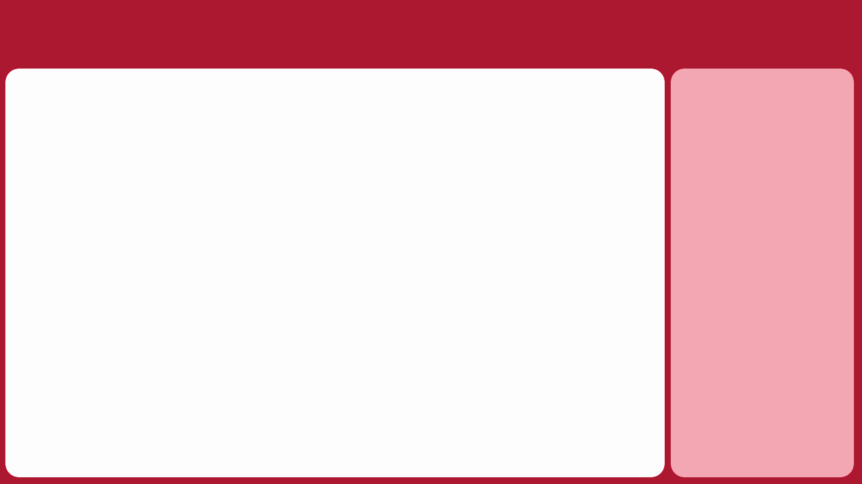
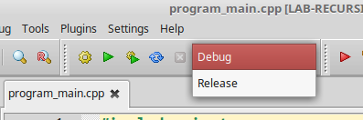
1. Running in Debug Mode
Notes
When you’re working on a program, you should always be running it in debug mode.
Once you’re ready to release your program, then you make a release build.
The Debug/Release dropdown menu in Code::Blocks; it is similar in Visual Studio.
(<number>/33)

Slide 6
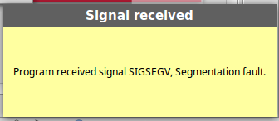
1. Running in Debug Mode
Notes
When you run your program in debug mode, it allows you to use debugging tools.
Additionally, when your program crashes, it will give you a chance to pause the program execution and investigate the problem.
Segfault in Code::Blocks
(<number>/33)

Slide 7
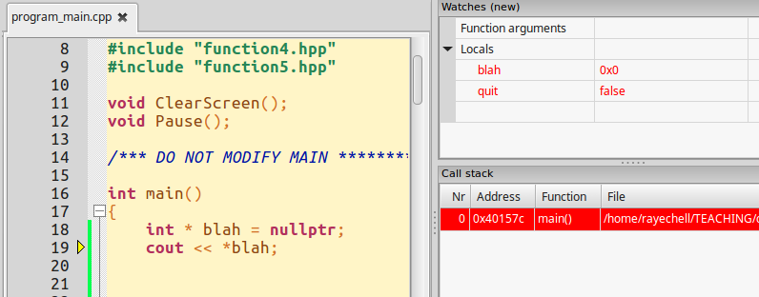
1. Running in Debug Mode
Notes
Code::Blocks pausing to investigate bad code.
(<number>/33)

Slide 8

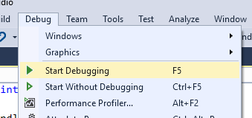
1. Running in Debug Mode
So make sure to always run your programs in DEBUG MODE!
Notes
Click me!
NOT ME!!
(<number>/33)

Slide 9
Breakpoints
& Stepping

Slide 10
2. Breakpoints & Stepping
When you have a logic error in your program, it might be hard to find the error. Logic errors don’t always cause crashes (such as just a bad formula), so you’ll really have to investigate to find the problem.
That’s where Breakpoints come in.
Notes
(<number>/33)

Slide 11
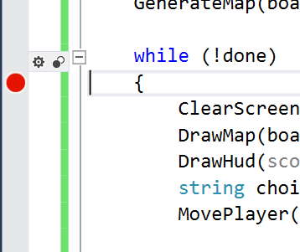
2. Breakpoints & Stepping
To set a breakpoint in your code, you can click in the gray bar to the left of the code window
Notes
(<number>/33)

Slide 12
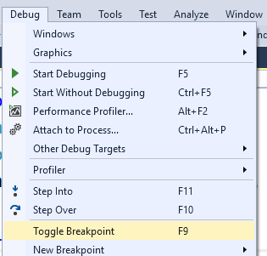
2. Breakpoints & Stepping
Or you can choose it from the dropdown menu when you have a line of code selected.
Notes
(<number>/33)

Slide 13
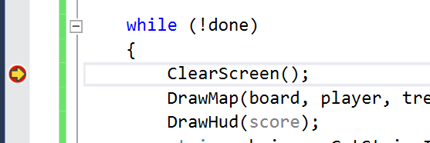
2. Breakpoints & Stepping
When a breakpoint is hit in debug mode the program will pause execution and take you to the IDE.
From a paused state, you can step through the code execution line-by-line, as well as investigate variable values.
Notes
It paused at this line.
(<number>/33)

Slide 14

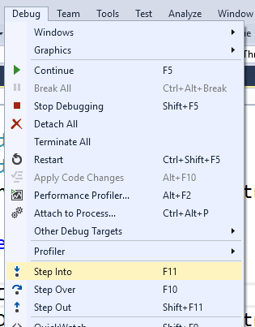
2. Breakpoints & Stepping
There are toolbar options to step through the code
Notes
Or you can access the options from the Debug drop-down menu.
(<number>/33)

Slide 15

2. Breakpoints & Stepping
Notes
When at a function, step into the function’s execution.
When at a function, step over it and go to the next line at the current scope
When inside a function, finish execution and step to the line after that function’s call.
(<number>/33)

Slide 16
Watching
Variables

Slide 17
3. Watching Variables
Notes
While you’re paused, you will probably want to check in on the value of some variables. There are several windows where you can do this.
(<number>/33)

Slide 18
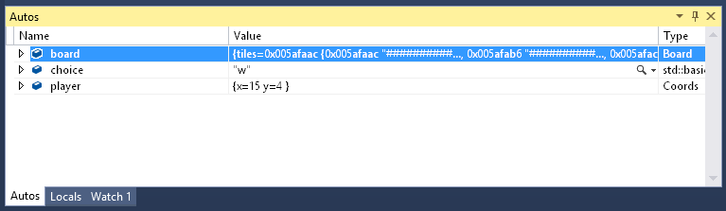
3. Watching Variables
Notes
The Autos pane will show you any variables used on the current or preceding line of code.
With structs/classes and arrays, you can use the ► icon to show member variables or elements & their values.
(<number>/33)

Slide 19
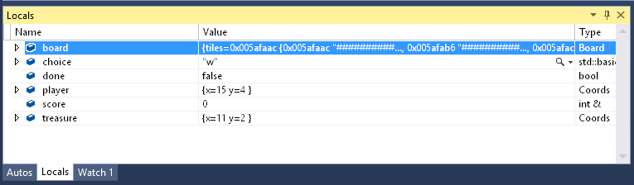
3. Watching Variables
Notes
The Locals pane will show you variables that are currently in scope.
(<number>/33)

Slide 20
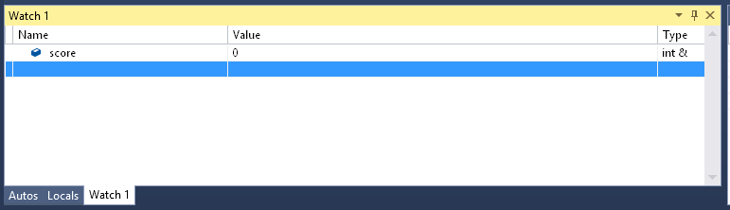
3. Watching Variables
Notes
In the Watch pane, you can type in a variable name to track it throughout the entire program execution.
(<number>/33)

Slide 21
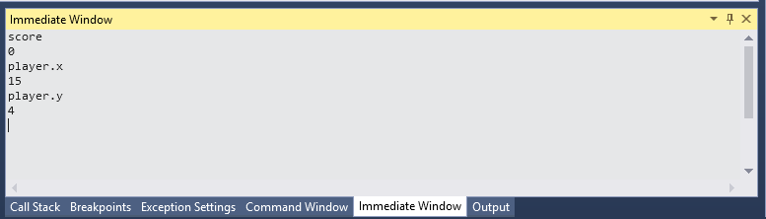
3. Watching Variables
Notes
And if you want to see a variable value quickly, you can use the Immediate Window to type in a variable name. After you hit ENTER it will show you that variable’s current value.
(<number>/33)

Slide 22
Call Stack

Slide 23
4. Call Stack
Notes
Another useful debugging tool is the Call Stack, though it might look intimidating at first.
When your program execution is paused, the Call Stack will show you the functions that have been called in order to get to where you’re currently at.
(<number>/33)

Slide 24
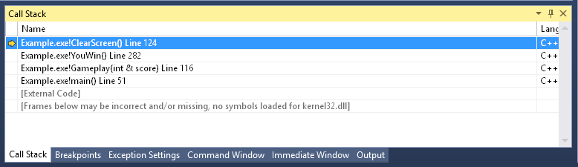
4. Call Stack
Notes
The Call Stack can be invaluable to trace the path that your program is following.
Above, we can read that:
main() called Gameplay(int& score),
Gameplay() called YouWin(),
YouWin() called ClearScreen()
(<number>/33)

Slide 25
Extra: Tips for navigating code

Slide 26
5. Extra Tips
Notes
Here are some extra tips for navigating your code…
(<number>/33)

Slide 27
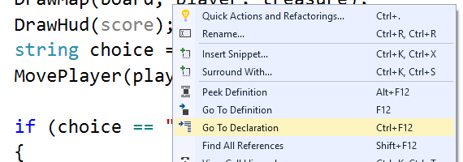
5. Extra Tips
Notes
When you right-click on a function, you can choose “Go To Declaration” to go to the function declaration.
If it’s a class method, it will go to the .h/.hpp file where the function is declared.
(<number>/33)

Slide 28
5. Extra Tips
Notes
The “Go To Definition” option will go to the implementation of the function. If it is a class method, this is in the .cpp file.
(<number>/33)

Slide 29
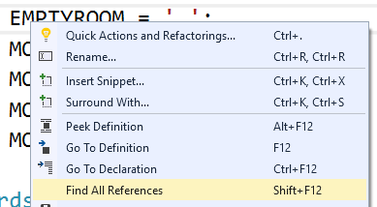
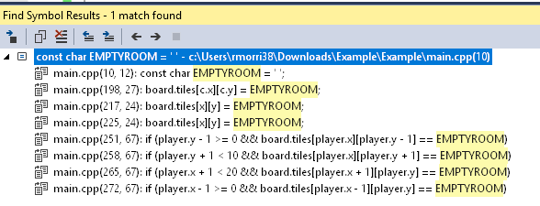
5. Extra Tips
Notes
The “Find All References” will show you where in the code some variable is being used.
(<number>/33)

Slide 30

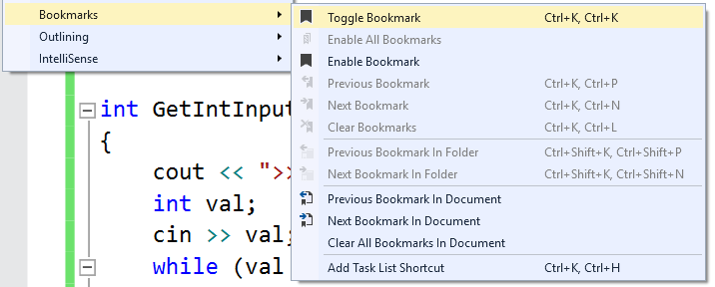
5. Extra Tips
In the Edit > Bookmarks menu, you can set places in your code to access quickly.
Notes
(<number>/33)

Slide 31
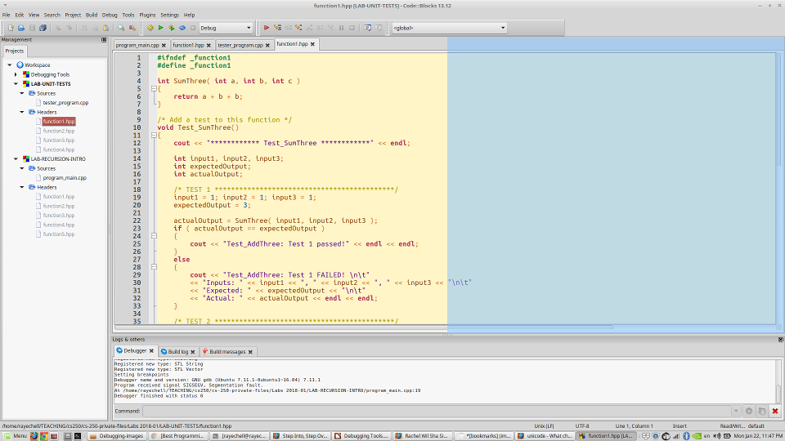
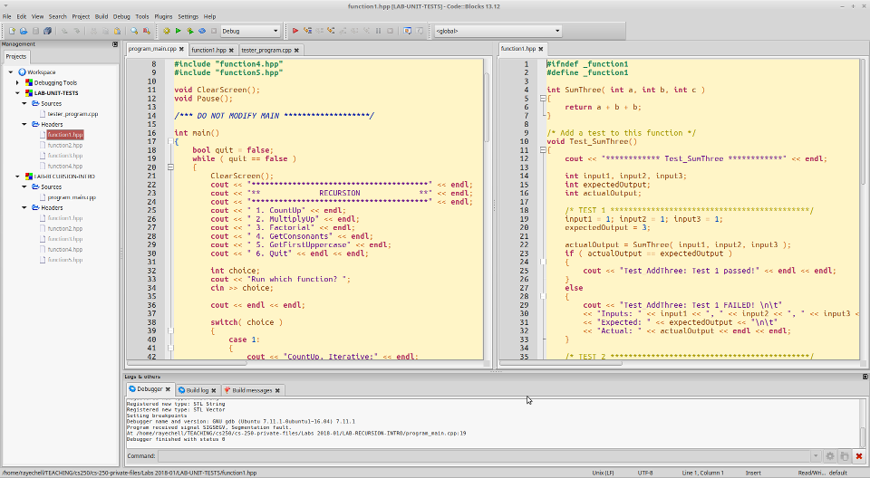
5. Extra Tips
If you click and drag one file to the side of another, Visual Studio and Code::Blocks will let you show both windows side-by-side.
Notes
(<number>/33)

Slide 32
5. Extra Tips
You can also split a single code file view under Window > Split so that you can reference two areas in the same code file at once.
Notes
(<number>/33)

Slide 33
Conclusion
This was just a quick overview of debugging tools that you can (should) use.

